Slide 1
Level 4/5 Group 15
Concept Pitch

Slide 2
Brief
For 2 players
Physics based
Adversarial
(i.e. “...characterised by conflict or opposition” – Oxford Dictionary)
On a single device
(i.e. No hidden information)

Slide 3
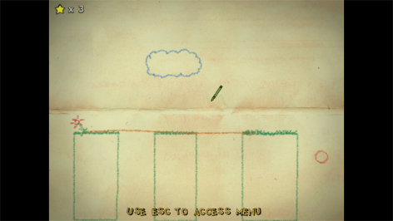
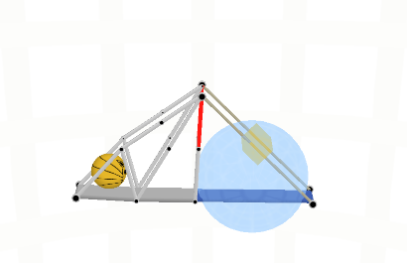
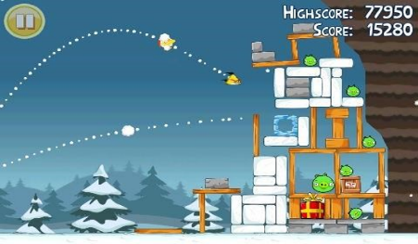
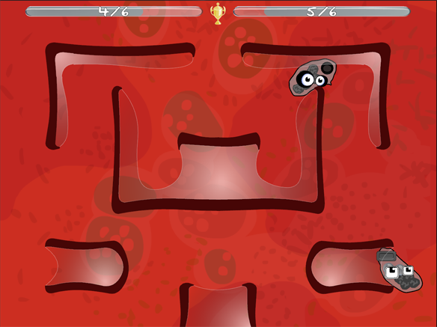
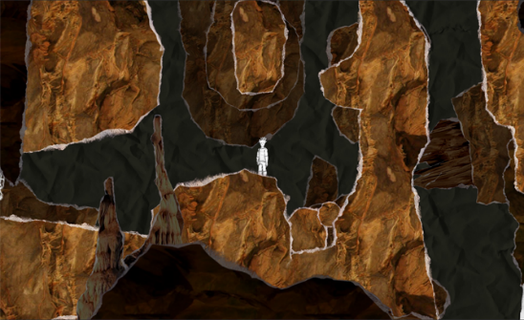
Research – Other Games

Slide 4
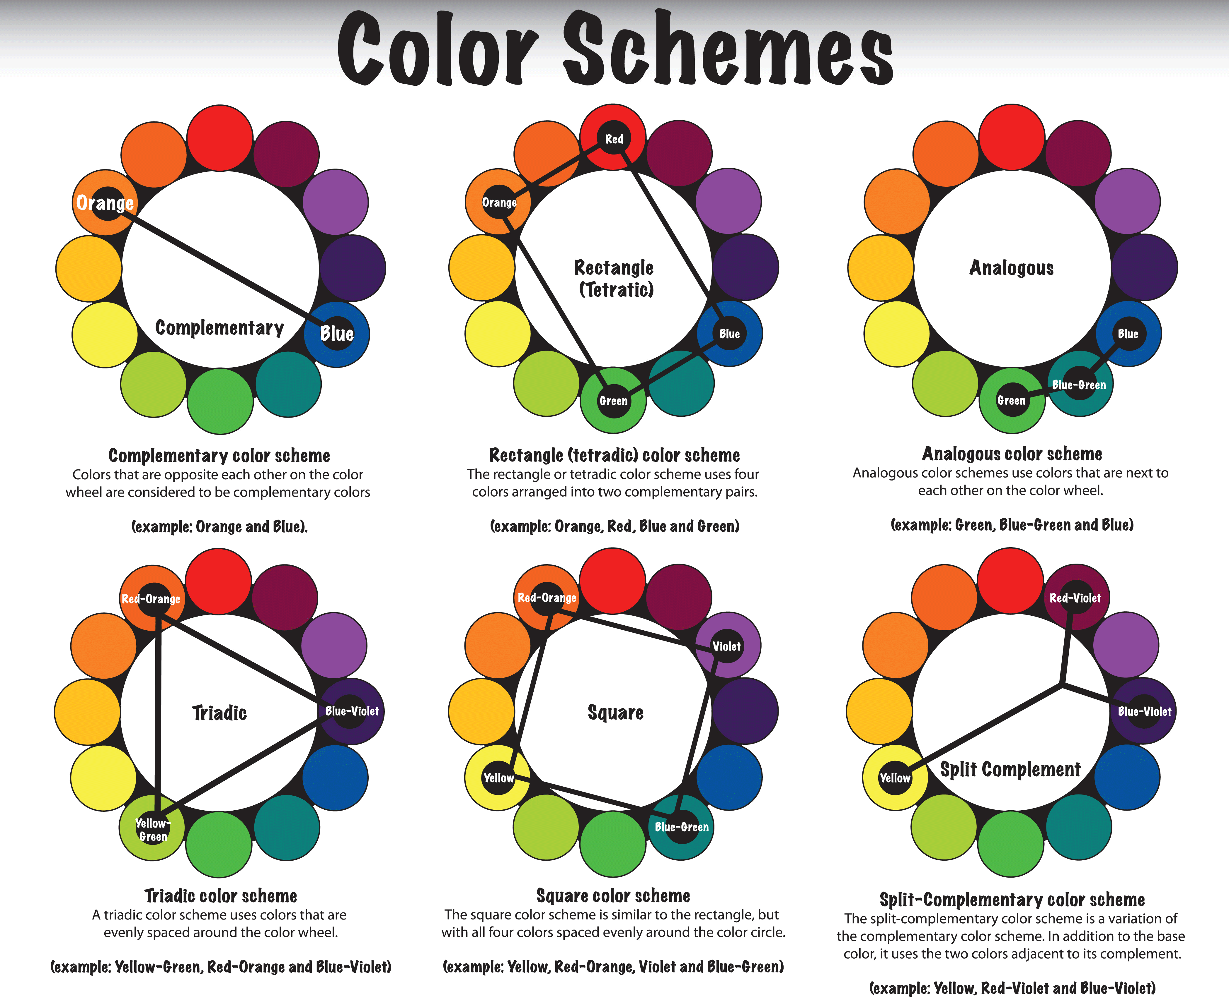
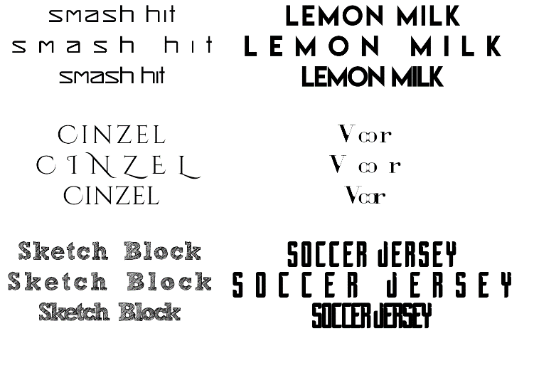
Research - Targeted
Demographic: Males, 10-13 (Schell)
Destructive Swinging

Slide 5




Research – Art

Slide 6
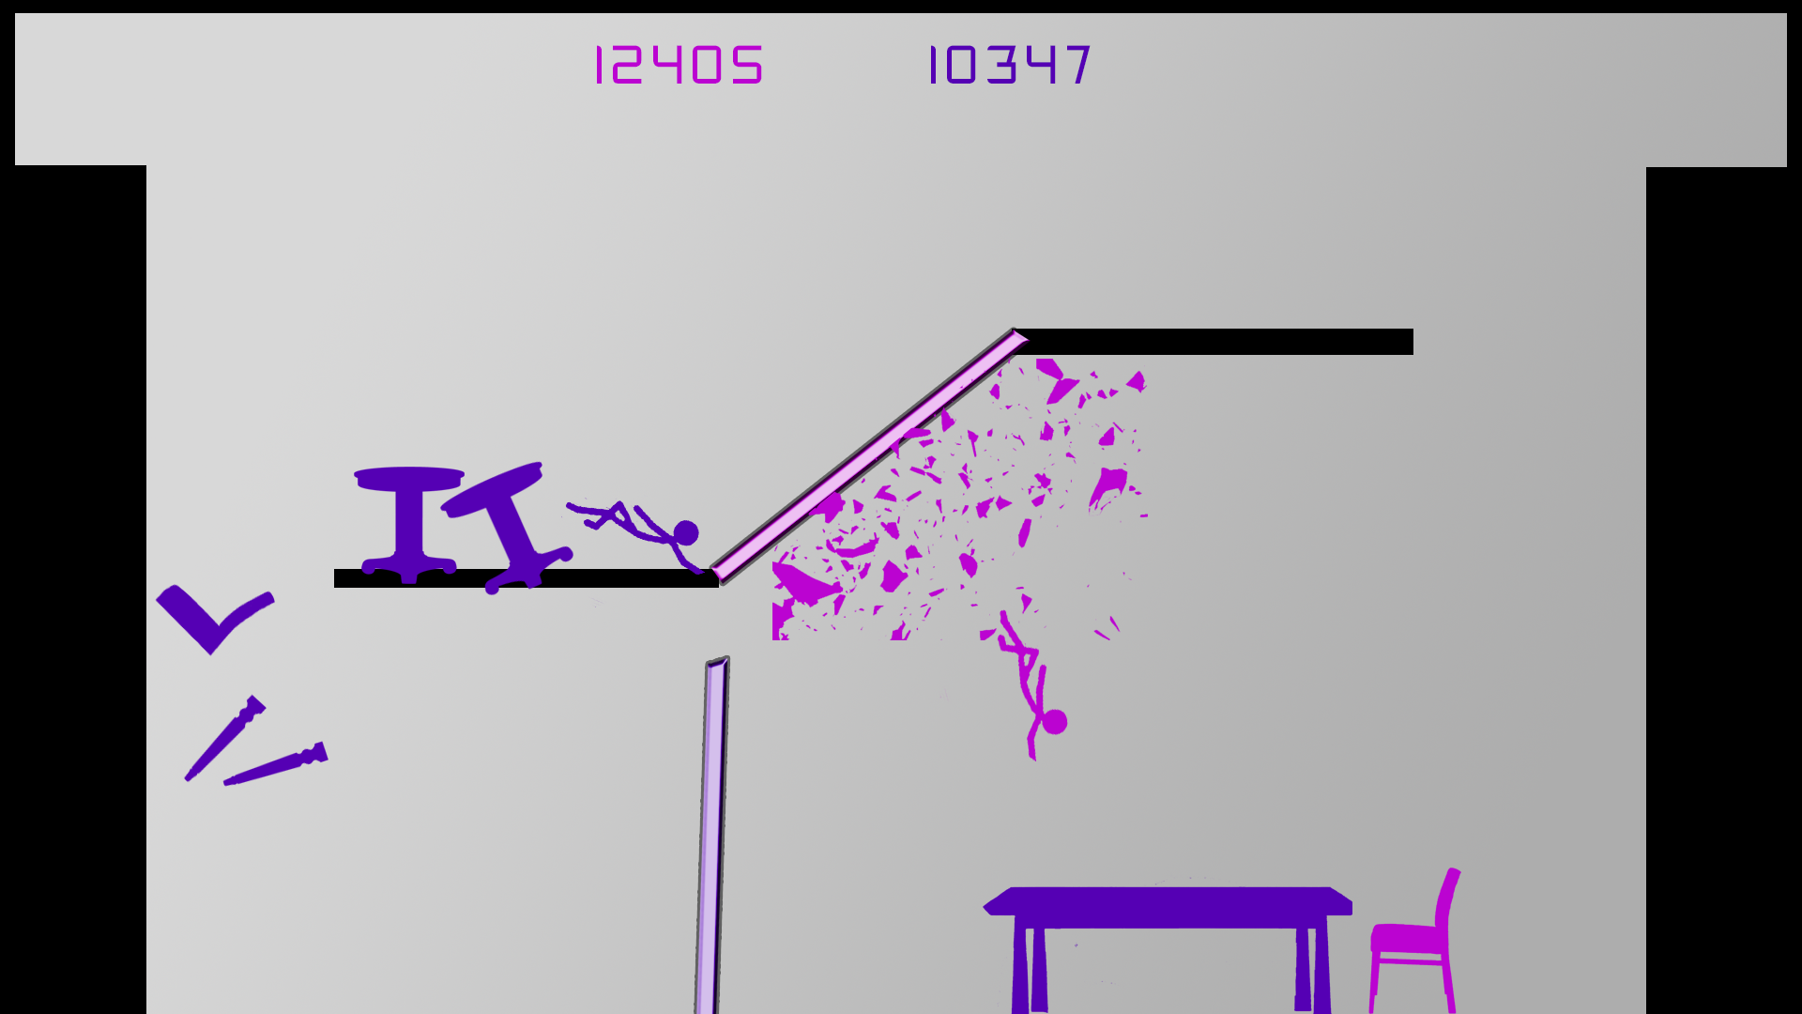
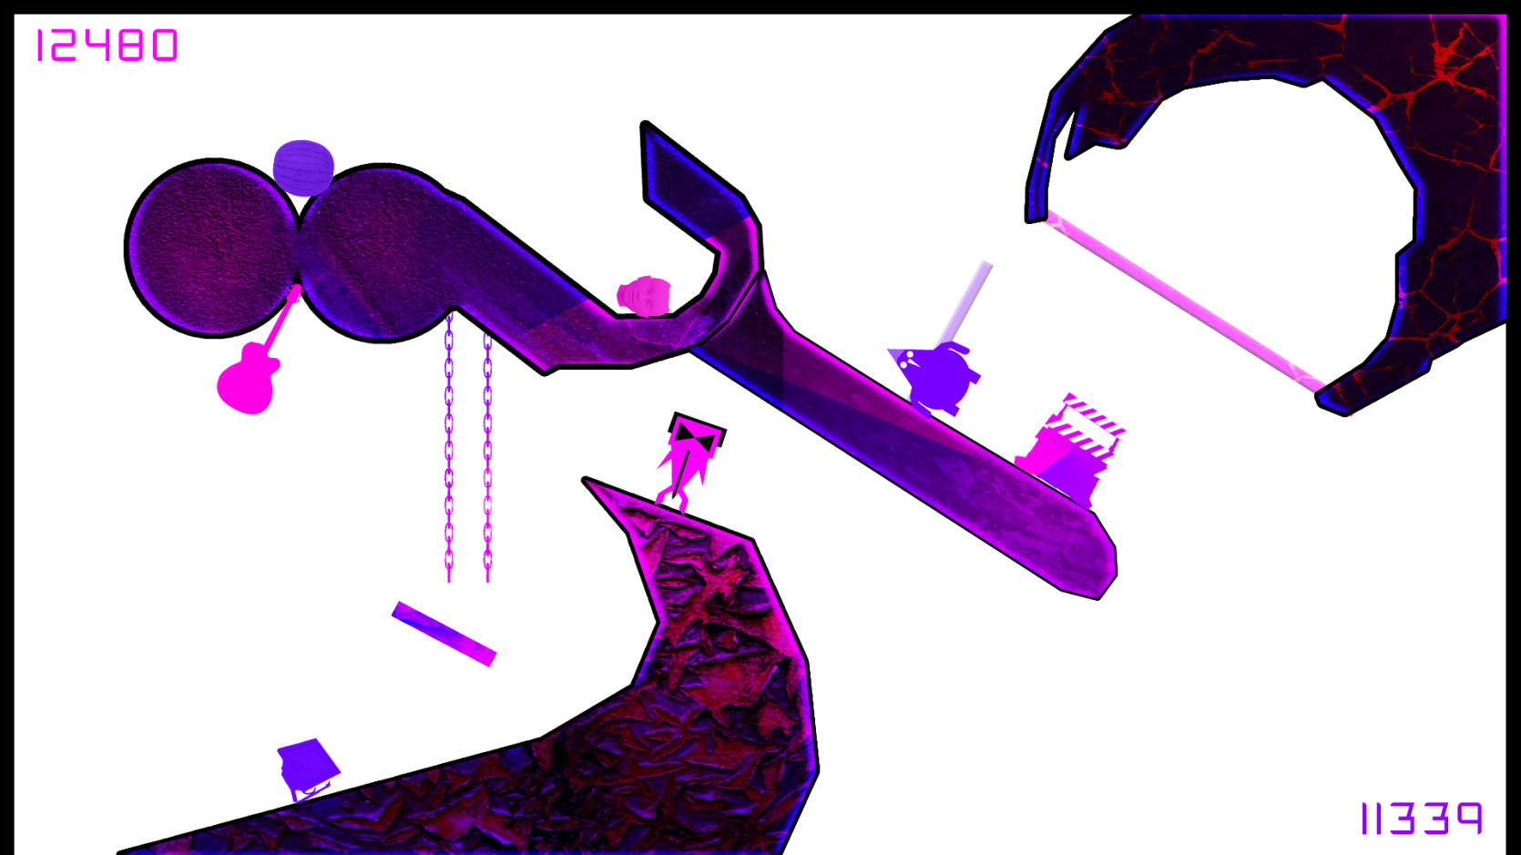
Our Game

Slide 7
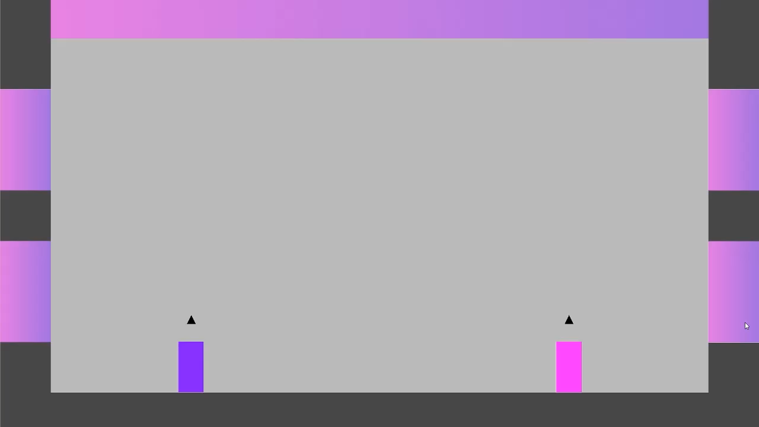
Prototype
https://www.youtube.com/watch?v=xYhbxN5J2xY

Slide 8
Feedback/Questions?

